Slide 1


Group 18: Ben Cheng, Linna Jia, Mengchu Wang, Yan Li, Iris Zhou

Slide 2
Agenda
Overview of the Application
Database Design & E-R Diagram
Shiny App Demonstration

Slide 3
What is
?

Slide 4
Application Overview
WHAT: Like-minded is an app that will help users to find and join groups related to their personal interests and connect people outside of their social circle.
WHO: Anyone who is looking for like-minded people
WHERE: Major US Cities (CA,IL,NY)
HOW:
User can search for categories or groups based on location and the topics
Once user create an account, they can use the website to join "like-minded" (groups) that interest them.
Users are also able to create new group if there are no matches with their interests.

Slide 5
Our Goal
Serve as a search engine for the end-users to access information about categories, groups and events in the database
Provide a platform for users to store member information, and manage their interested groups after sign up
Visualize the events information to better explore the opportunities
Give insights through graphing the relationships among entities in interactive analytics dashboard

Slide 6
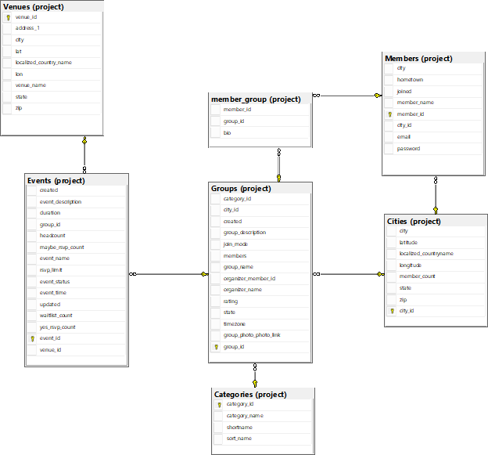
E-R Diagram

Slide 7
Database Design - Entities
Categories: category id(PK), category name
Groups : group id(PK), group name, group description, rating, city, state
Events: event id(PK), event name
Members: member id(PK), member name, email, password
Cities: city id(PK), city, longitude, latitude
Venues: venue id(PK), longitude, latitude

Slide 8
Transformation ER Diagram to Tables
One-to-many relationship
One category has many groups. A group must belong to only one category.
One group has many events. An event must belong to only one group.
One city has many groups. A group must belong to only one city.
One city has many members. A member must belong to only one city.
One venue has many events. An event must belong to one venue.
Many-to-many relationship
Groups can have many members. Members can join many groups.
Created associative entity member_group

Slide 9
Normalization of Tables
Normalized the tables to the third normal forms
No duplicate data
All column data depend on full primary key
No column is depend on other columns

Slide 10

Demo of Shiny Application

